Slide 1
Strategic Plan & Scope
High Level Network Architecture
Network Design
Deployment
Operations & Maintenance
Field Maintenance
Post-Launch Engineering
Supply Chain Management
Network HLD
Network LLD
Selected Equipment & Vendors
Business Strategy
Deployment
Deployment Management
Site Survey
Site Construction Management
I&C: Inside Plant
to Operations
Fiber Construction Management
I&C: Outside Plant

Slide 2
Site Construction Management
2
3
Site Survey
Vendor Management
Management/Oversight
Kickoff
Project Plan
Milestone tracking
Stakeholder Management
Reporting
Vendor Management
Test & Acceptance (checklist)
Site Construction
Site Solution
LLDs / Site Engineering Document
1
Vendor evaluation and selection
------------
Contracting / MSA
Vendor Selection
RFx template
Site Construction RFI/RFP
Tech Specs
Area specific specs
Architecture & HLDs
Tech Specs

Slide 3
Site Survey
Site
Survey
Eng. Design
(RF+Tx)
Site Survey
Generate Technical Site Survey Report
Site Acq.
Acquisition and Permits
Site Acquisition
Site Permits
Produce Site Construction Work Order
A
Start Site
Construction
Site Construction
A&E
Analysis
Carry out Structural Analysis
Generate Site Engineering document
Yes
Validated?
No
Civil
Works
Redesign
Fencing / Shelter foundation
Tower Foundation
A1
New Tower
Site
A
Civil Works Material Transport
Site Preparation
Existing Tower reinforcement
A2
Existing Tower
Site
Start Site Construction
Rooftop reinforcement
A3
Rooftop
Site
Electrical & Mechanical
Works
A1
Tower Assembling and Erection
Shelter / Cabinet Erection
Antenna Mounts supply and installation
Cable construction components
Power construction components
Grounding & Lightning components
Construction Acceptance
New Tower
Site
Existing Tower
Site
A2
Start Site Installation
B
Rooftop
Site
A3
Site Inst.
Power and Equipment Installation
B
Power Installation
Equipment Installation
Antenna Installation
Cable Installation
Start Site Installation

Slide 4
RFI/RFP Process
Site Solution Catalogue
RF Requirements
TX Requirements
Site Construction considerations
Technical Site Survey
Technical Site Survey Report
Location
Access
Tower
Power
Grounding
Cabling
Report
Drawings
Photos

Slide 5
Site Solutions
Vendor Construction Partner to design Tower components based on Planned Load
New Tower Site
Planned Load
FEASIBILITY STUDY
Existing Load
Demand – Capacity Ratio increased by 5% ?
Construction Vendor requires to execute Comprehensive Structural Analysis
Existing Site
Yes
No
New Load
Structural Analysis not required

Slide 6
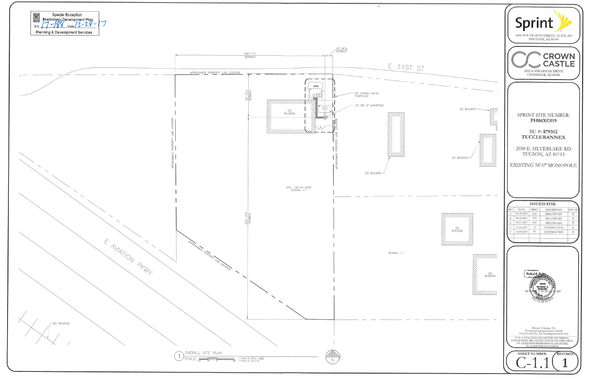

Slide 7
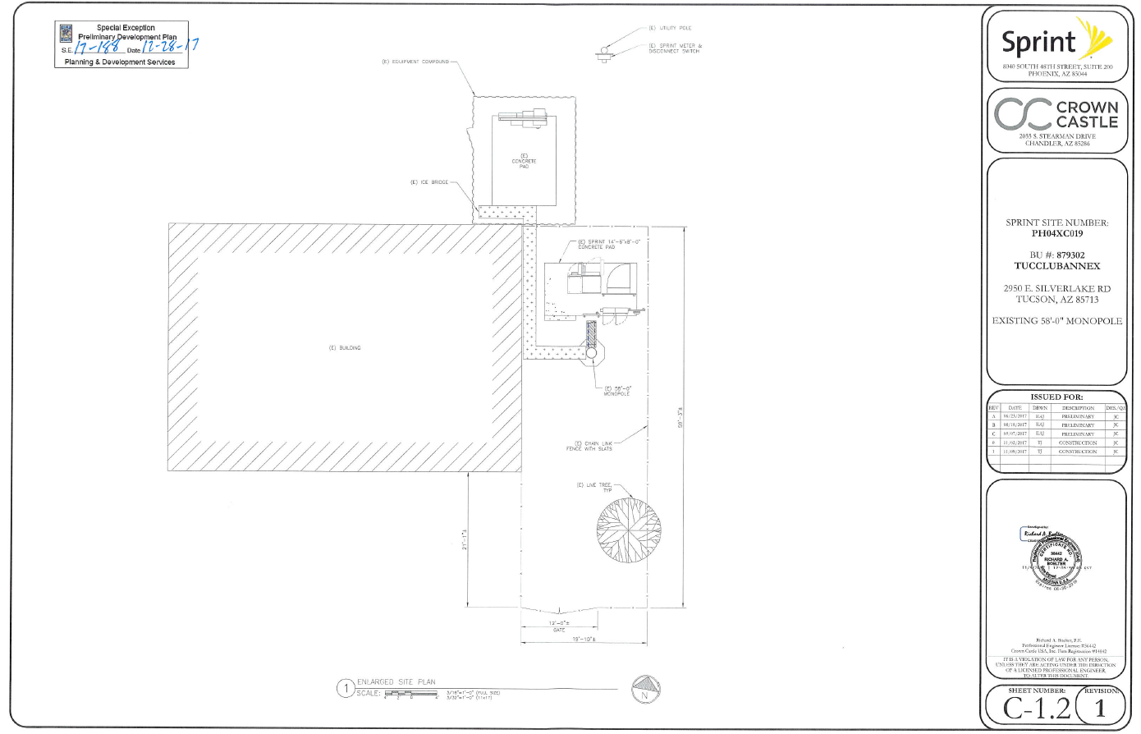

Slide 8
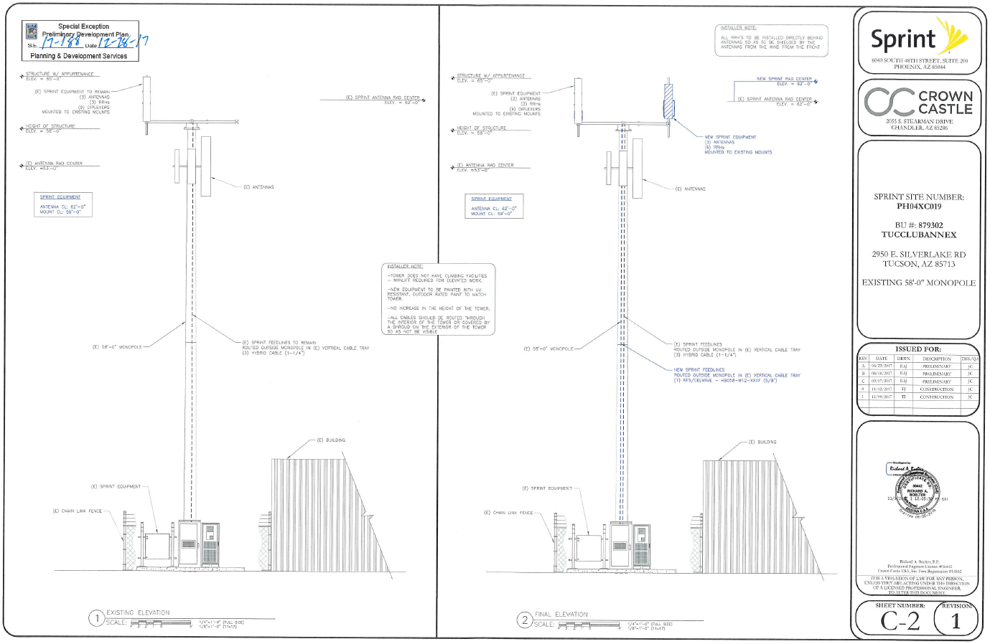

Slide 9
Fencing / Shelter foundation
Tower Foundation
A1
New Tower
Site
A
Civil Works Material Transport
Site Preparation
Existing Tower reinforcement
A2
Existing Tower
Site
Start Site Construction
Rooftop reinforcement
A3
Rooftop
Site

Slide 10
New Tower
Site
A1
Tower Assembling and Erection
Shelter / Cabinet Erection
Antenna Mounts supply and installation
Cable construction components
Power construction components
Grounding & Lightning components
Construction Acceptance
Existing Tower
Site
A2
Start Site Installation
B
Rooftop
Site
A3

Slide 11
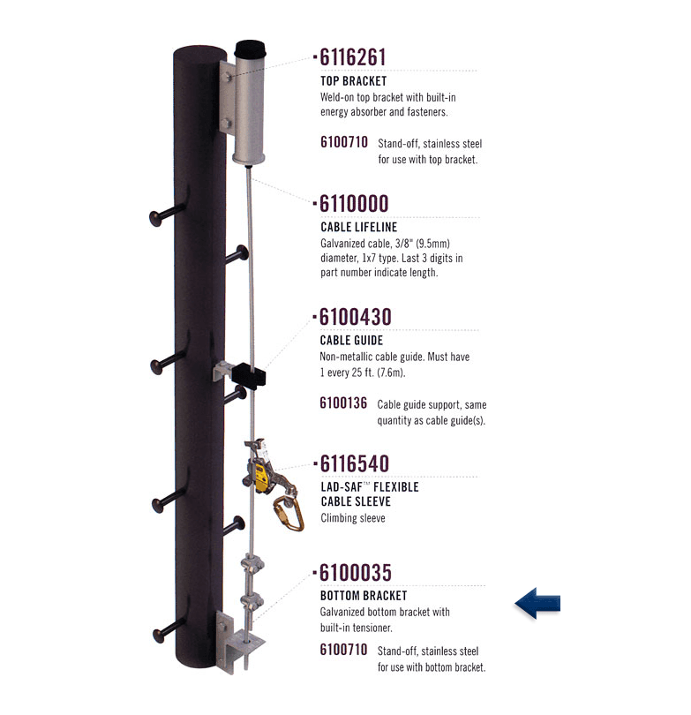
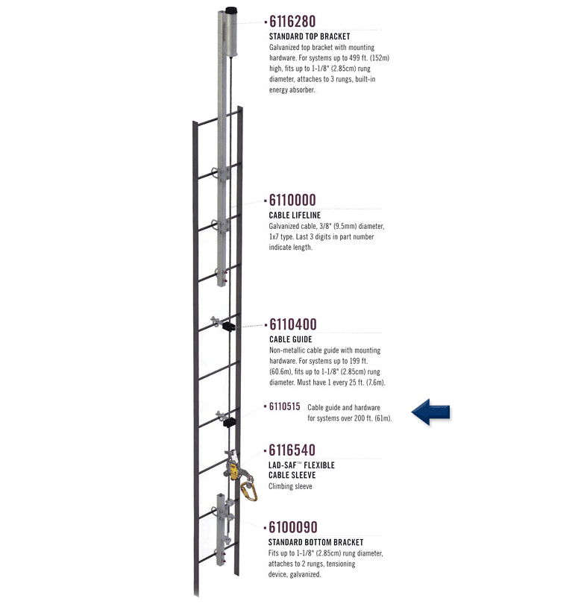

Slide 12
Towers & Rooftops
Antenna Mounting Structures
Cable Layout
Construction components
Power Supply
Construction components
Equipment Shelter
Construction components
Site Grounding
Construction components

Slide 13
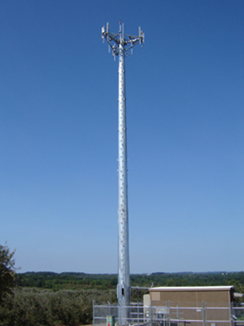

Slide 14
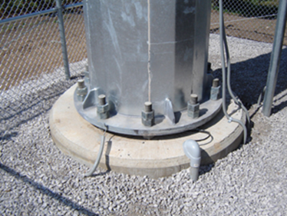

Slide 15
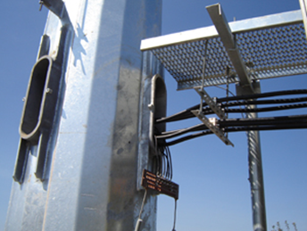

Slide 16
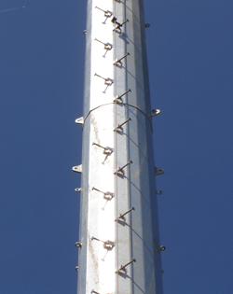

Slide 17
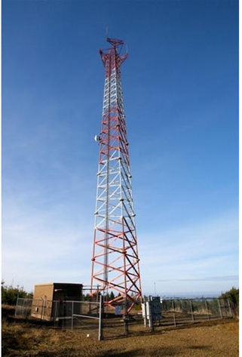

Slide 18
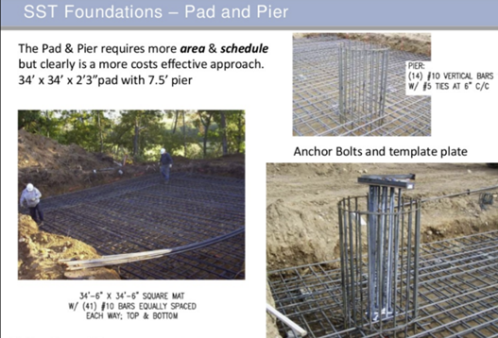

Slide 19
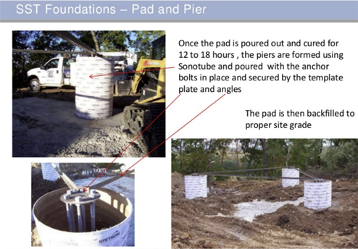

Slide 20
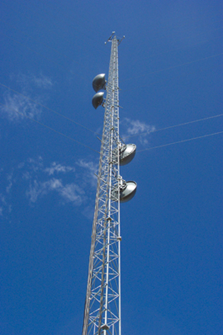

Slide 21
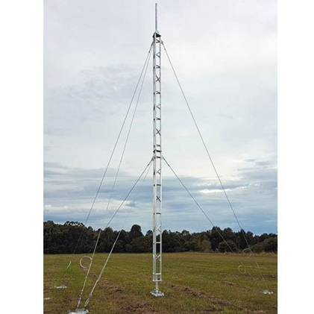

Slide 22
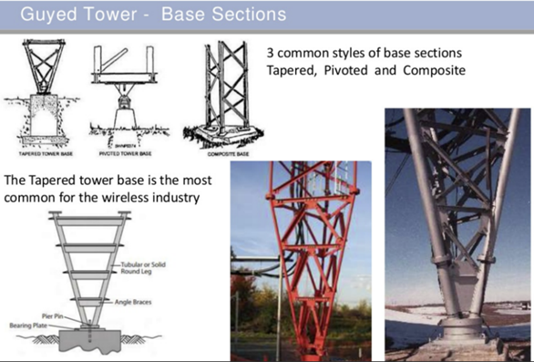

Slide 23
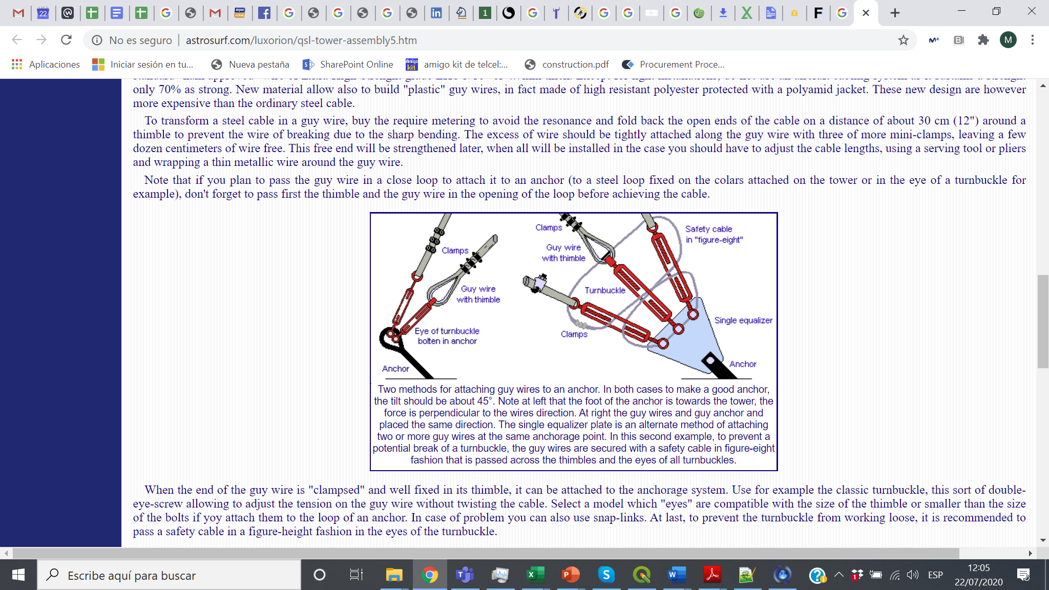
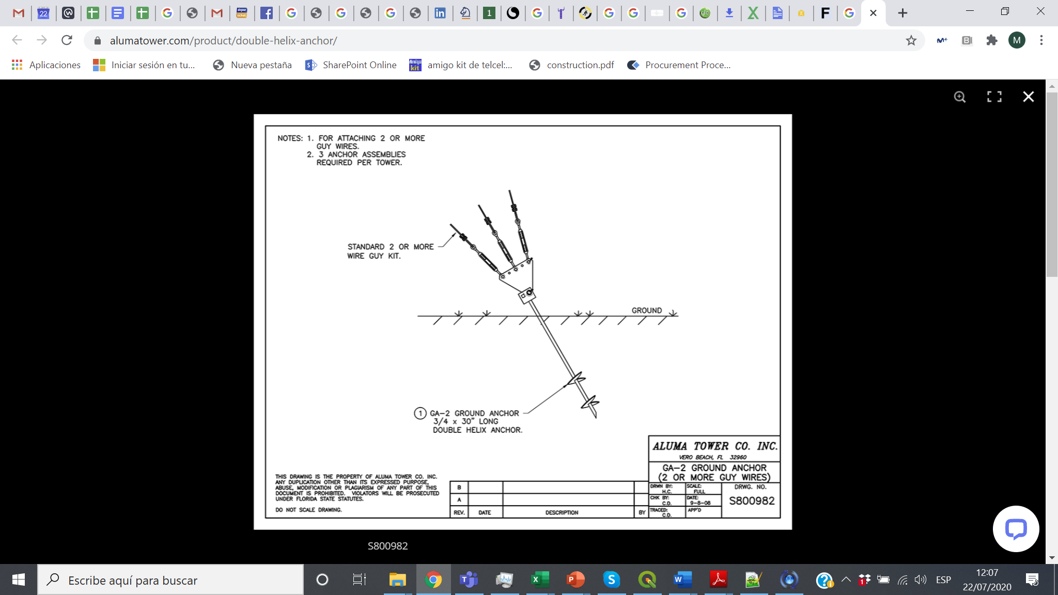
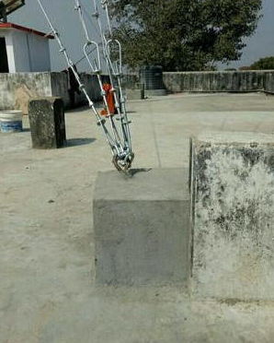

Slide 24
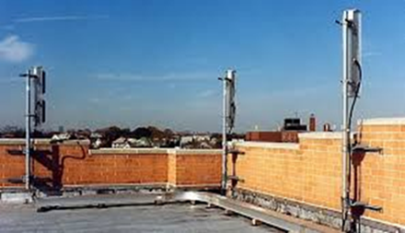

Slide 25
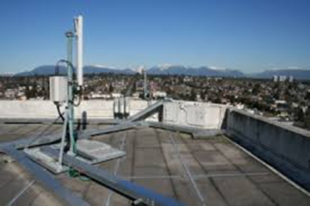

Slide 26


Slide 27


Slide 28
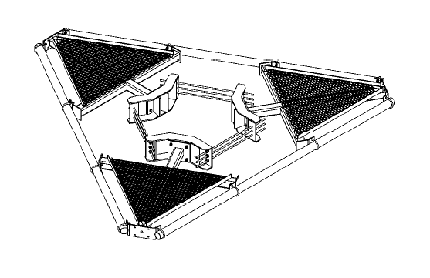
Section 3.1.2.1

Slide 29
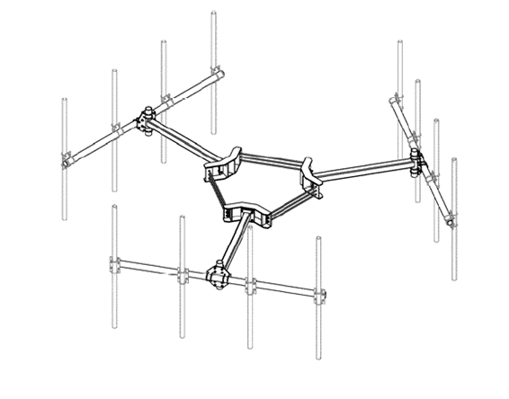
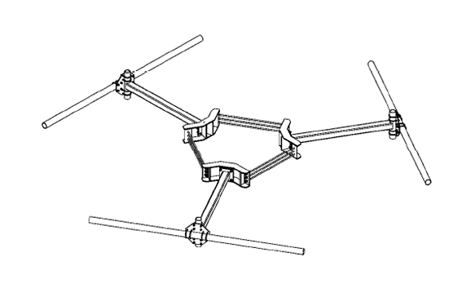
Section 3.1.2.1

Slide 30
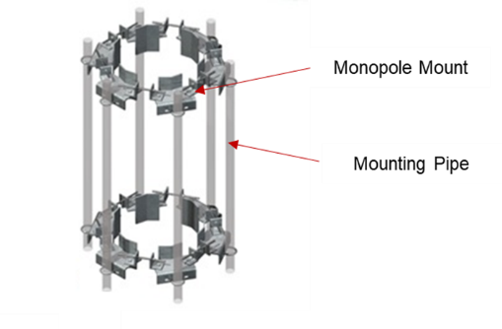
Section 3.1.2.1

Slide 31
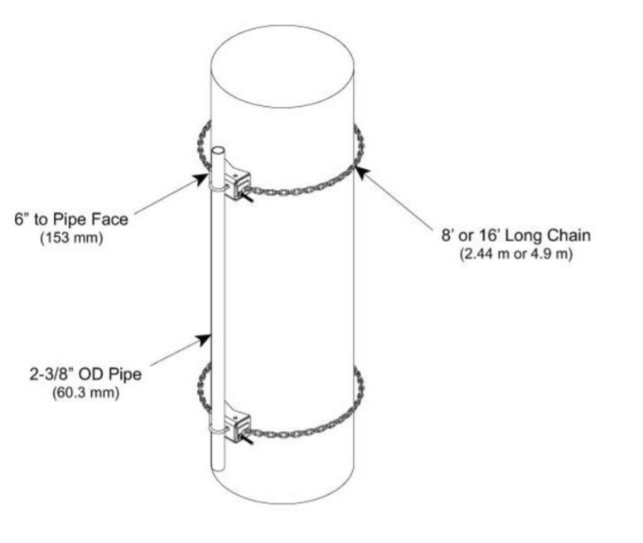
Section 3.1.2.1

Slide 32
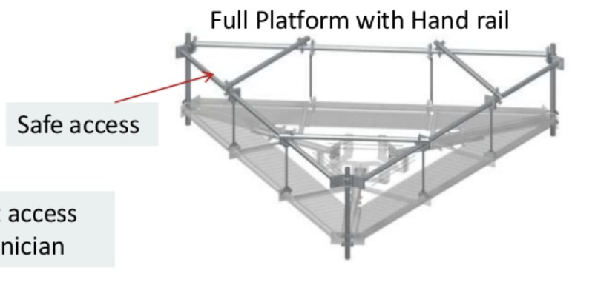
Section 3.1.2.1

Slide 33
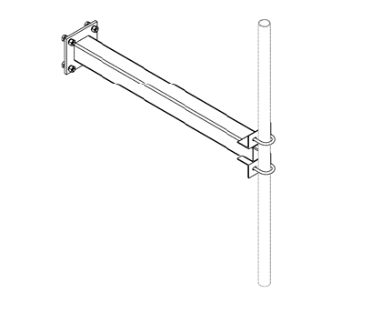
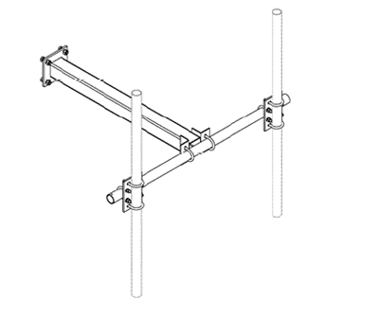
Section 3.1.2.1

Slide 34
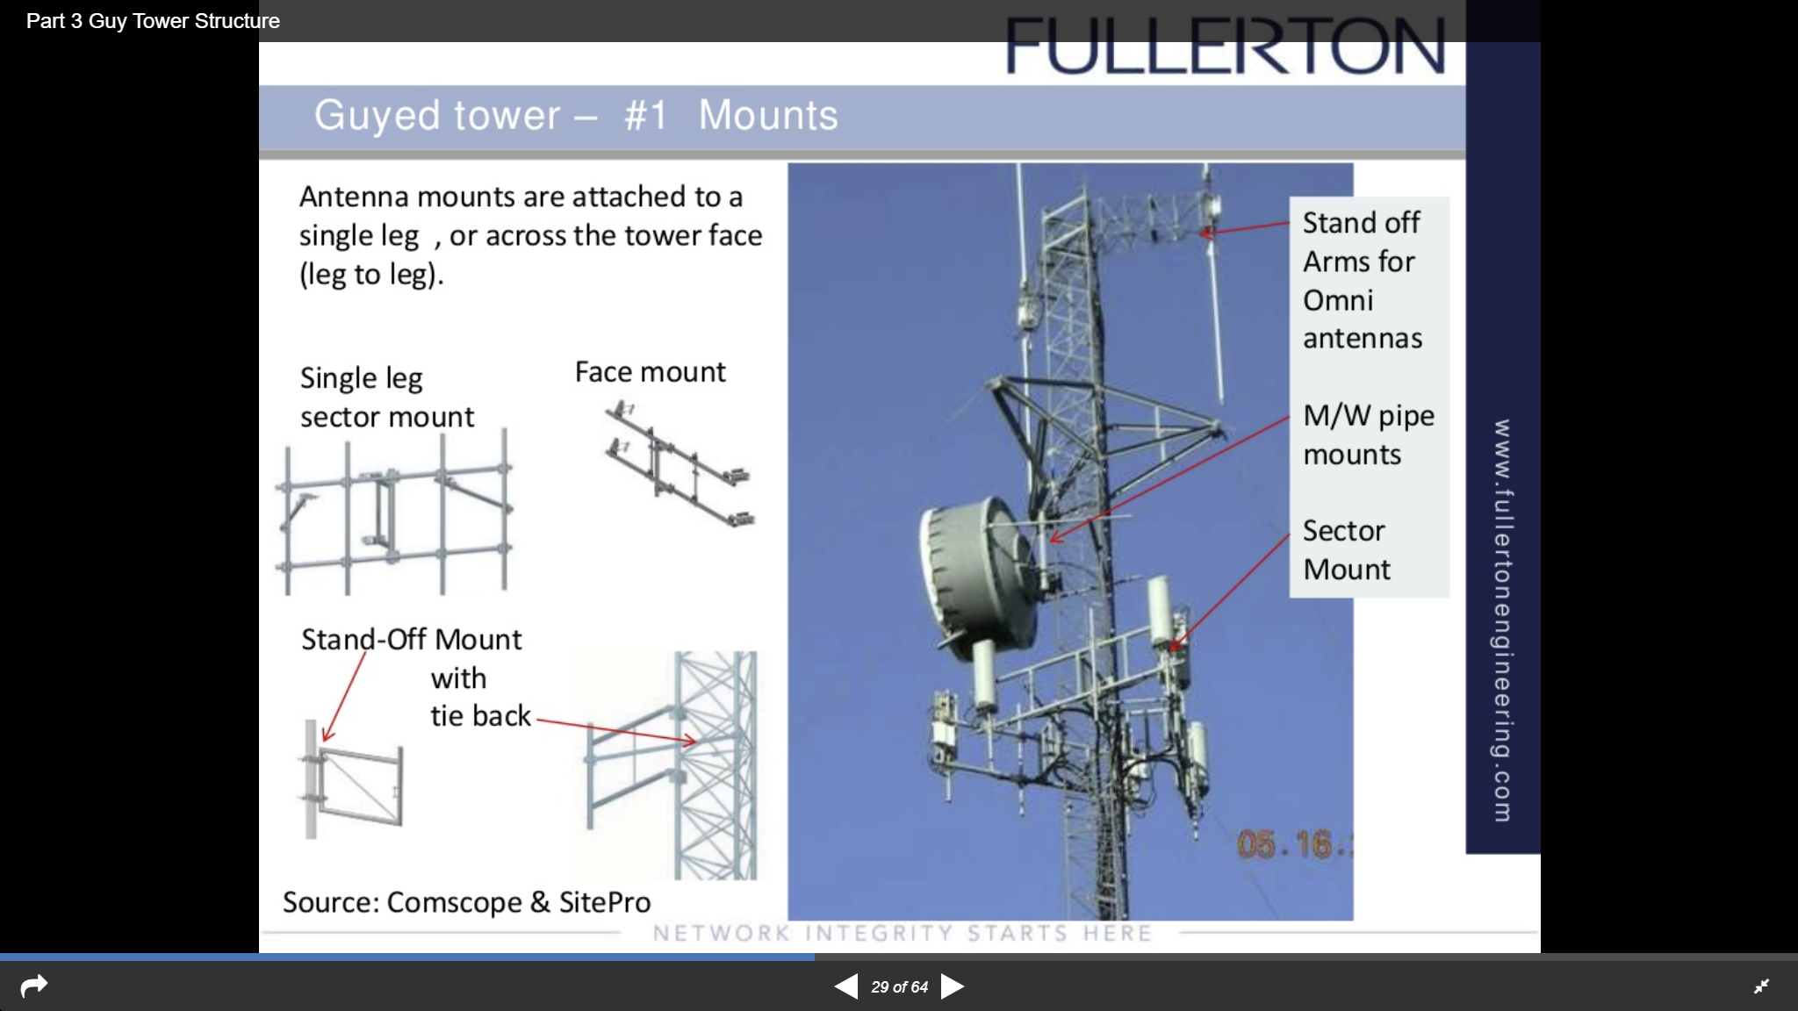
Section 3.1.2.2

Slide 35
Section 3.1.2.2

Slide 36
Section 3.1.2.2

Slide 37
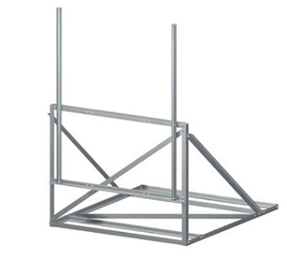
Section 3.1.2.3

Slide 38
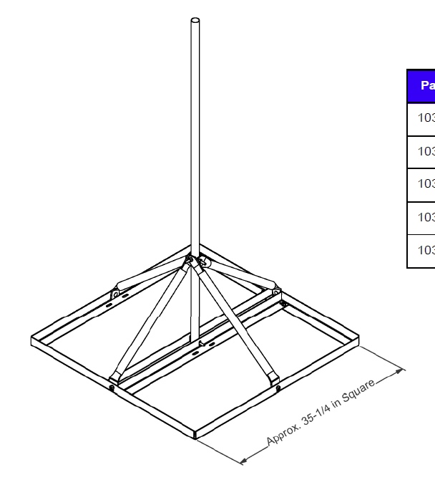
Section 3.1.2.3

Slide 39
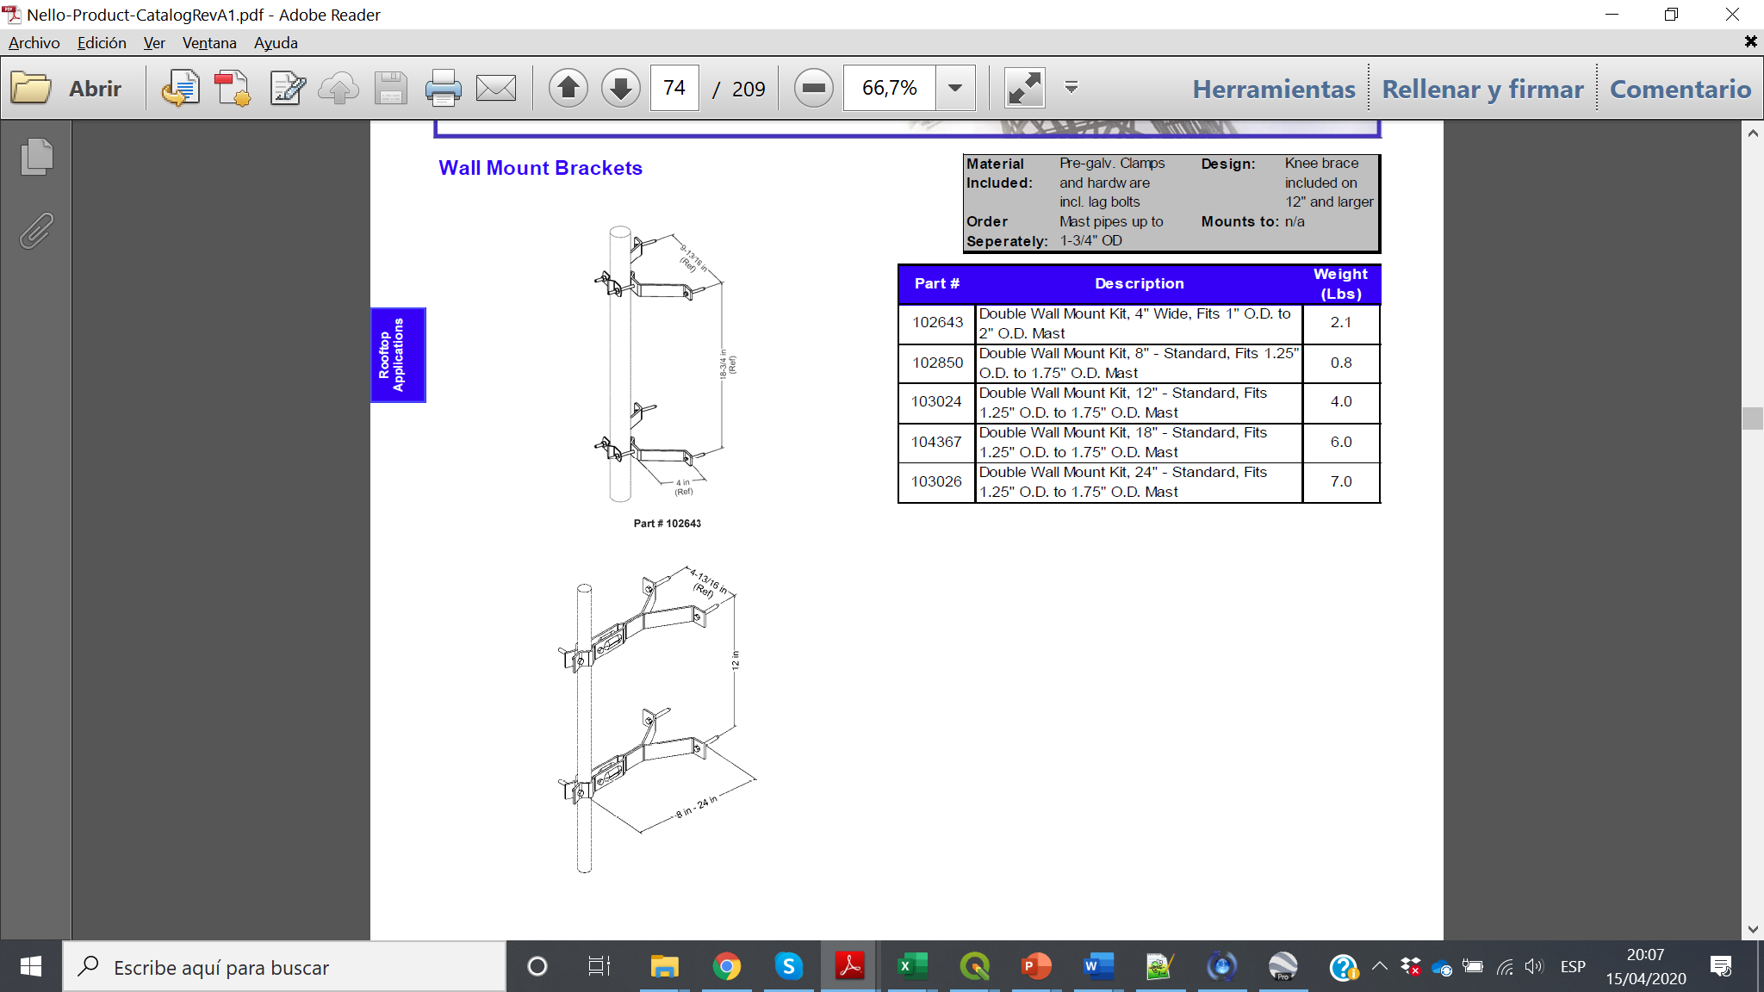
Section 3.1.2.3

Slide 40
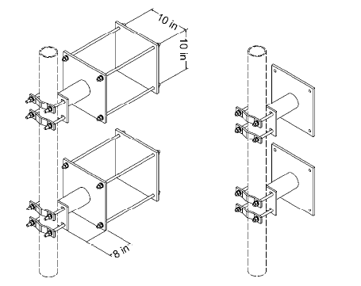
Section 3.1.2.3

Slide 41
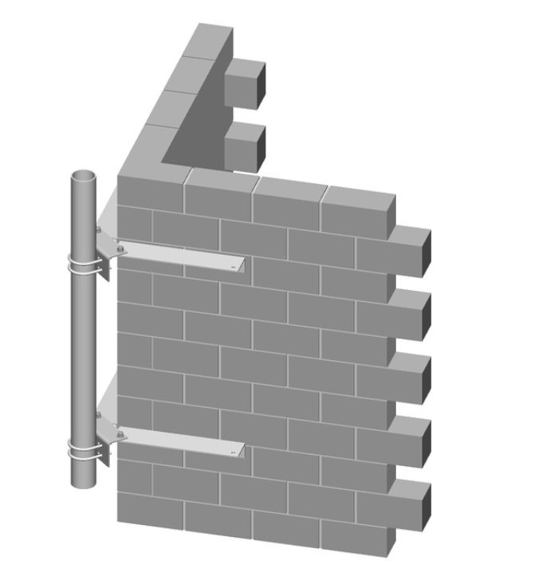
Section 3.1.2.3

Slide 42
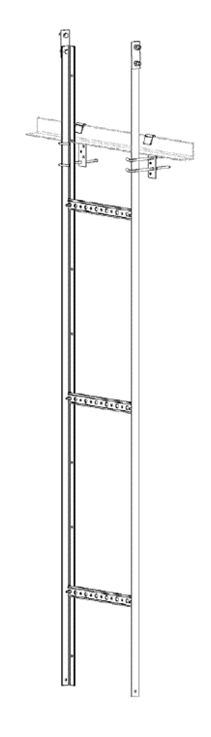
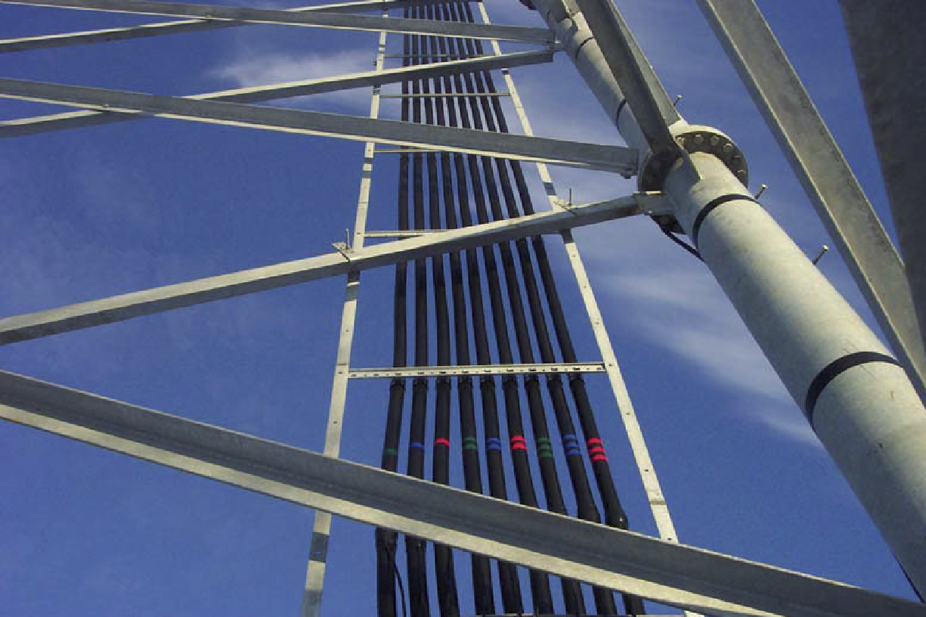
Section 3.1.3

Slide 43
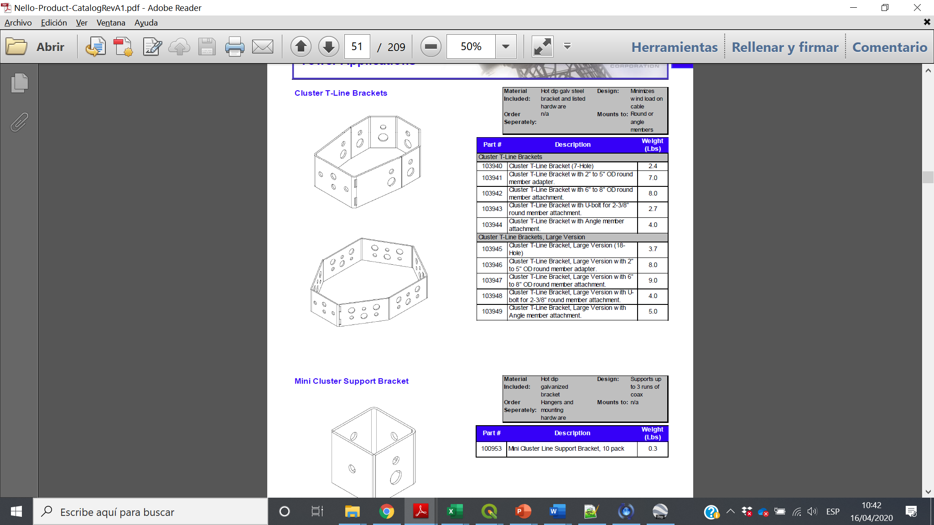
Section 3.1.3

Slide 44
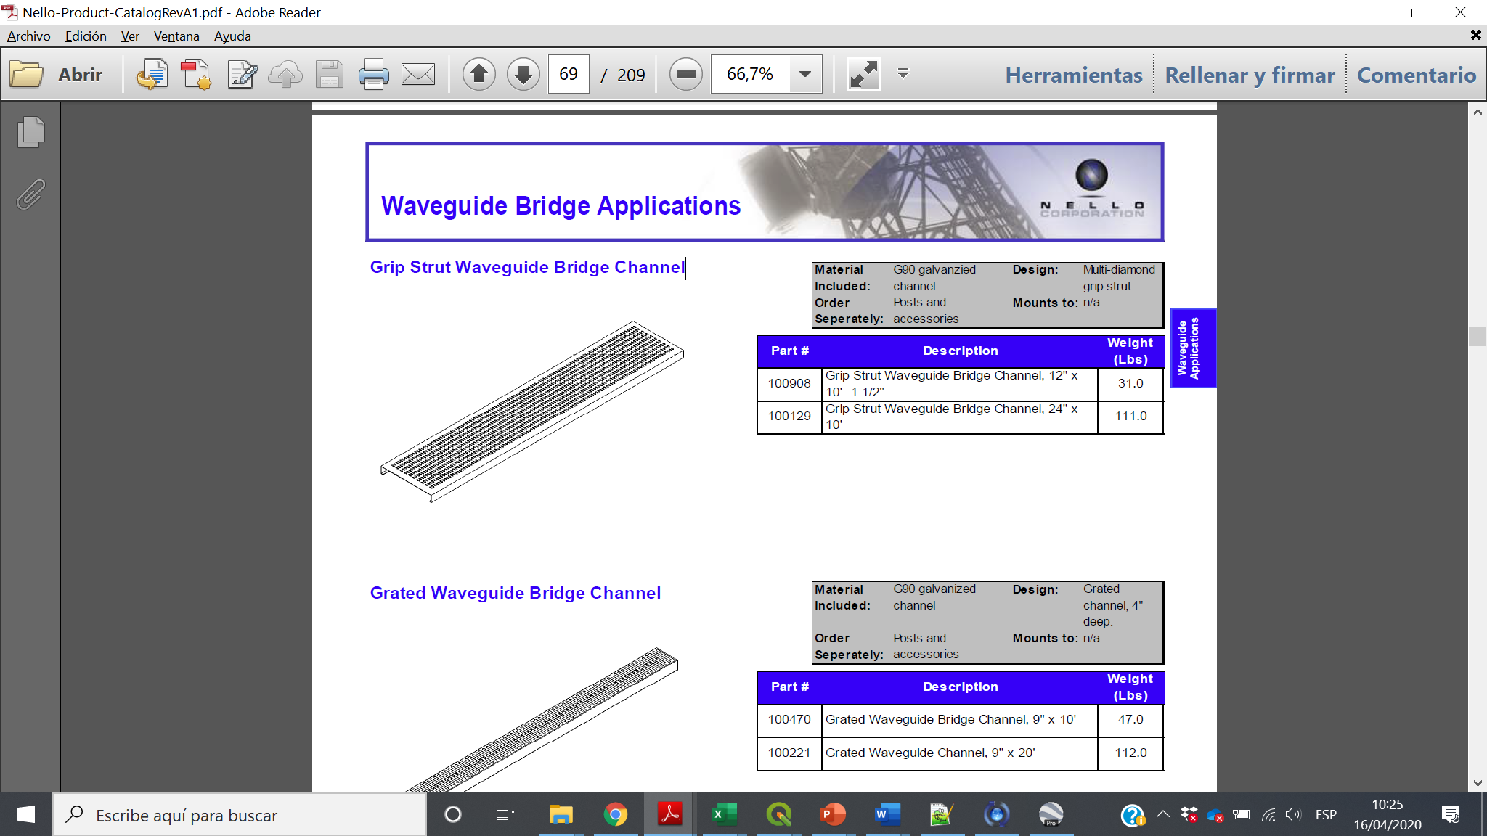
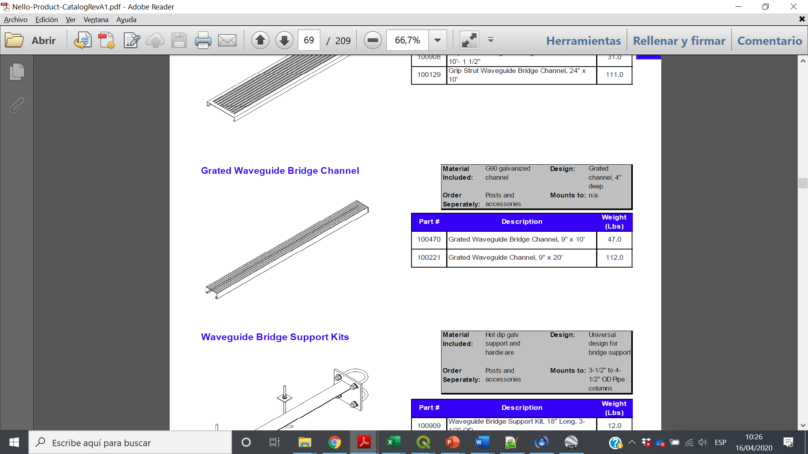
Section 3.1.3

Slide 45
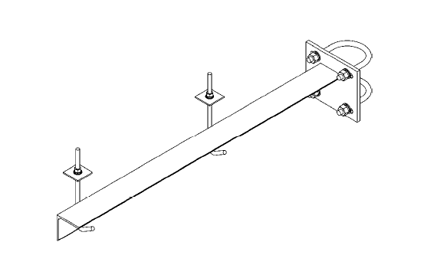
Section 3.1.3

Slide 46
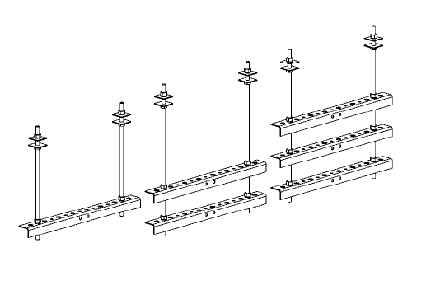
Section 3.1.3

Slide 47
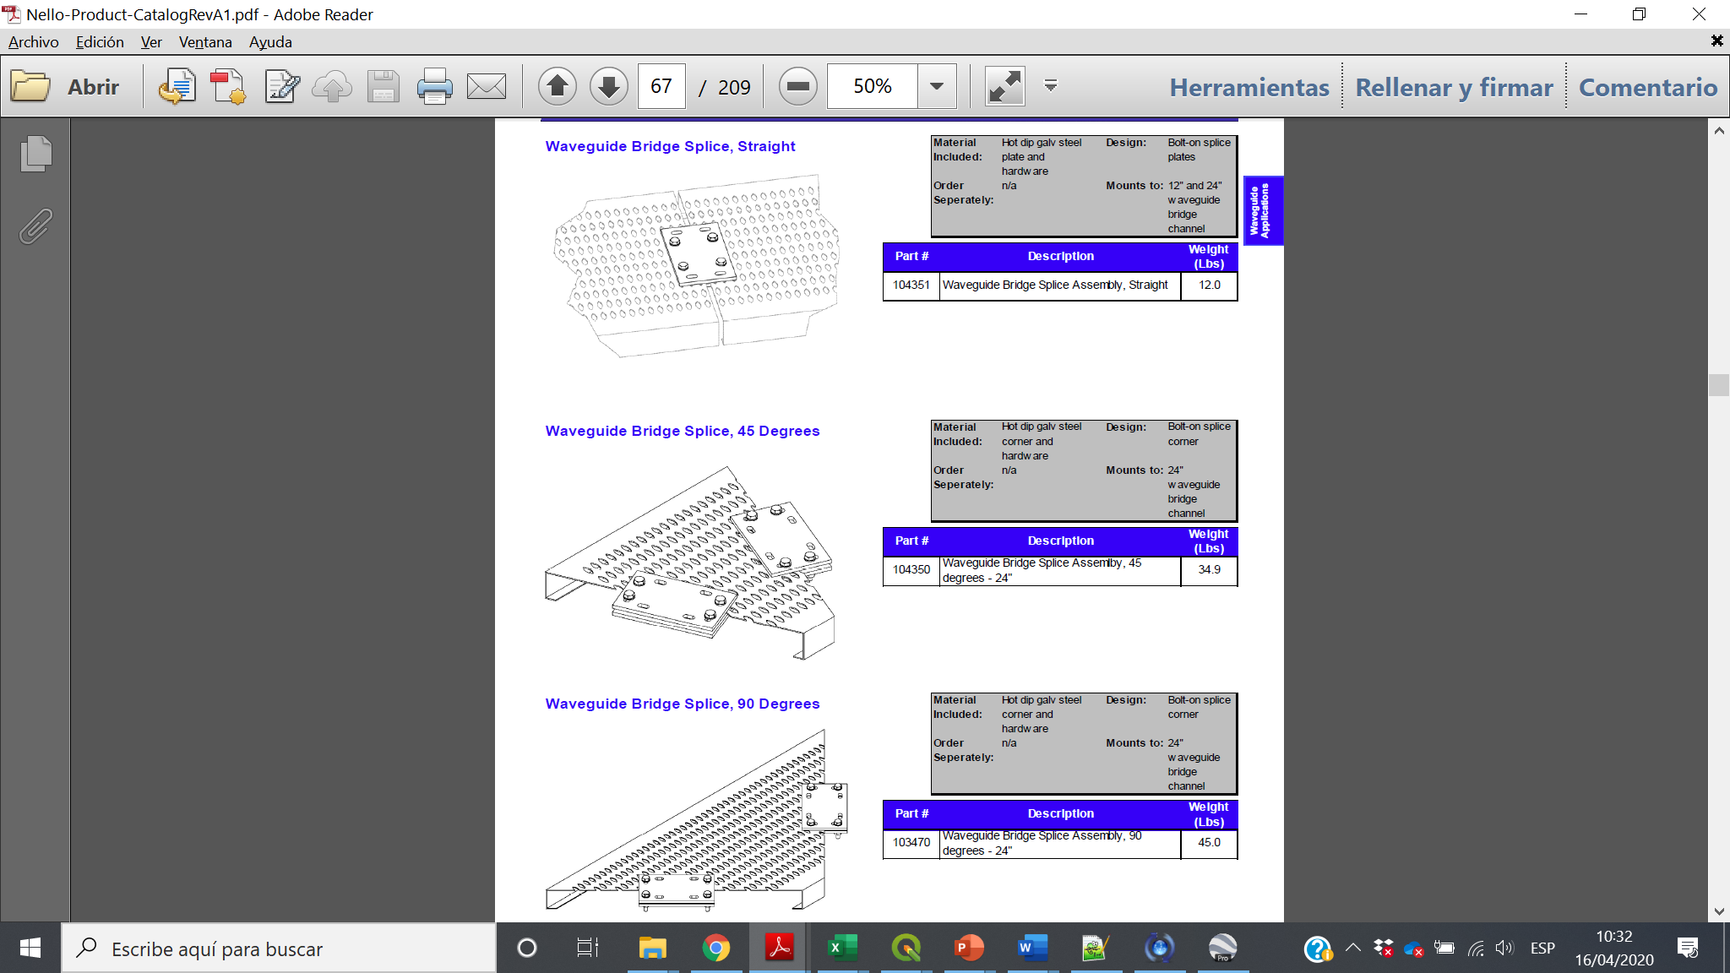
Section 3.1.3

Slide 48
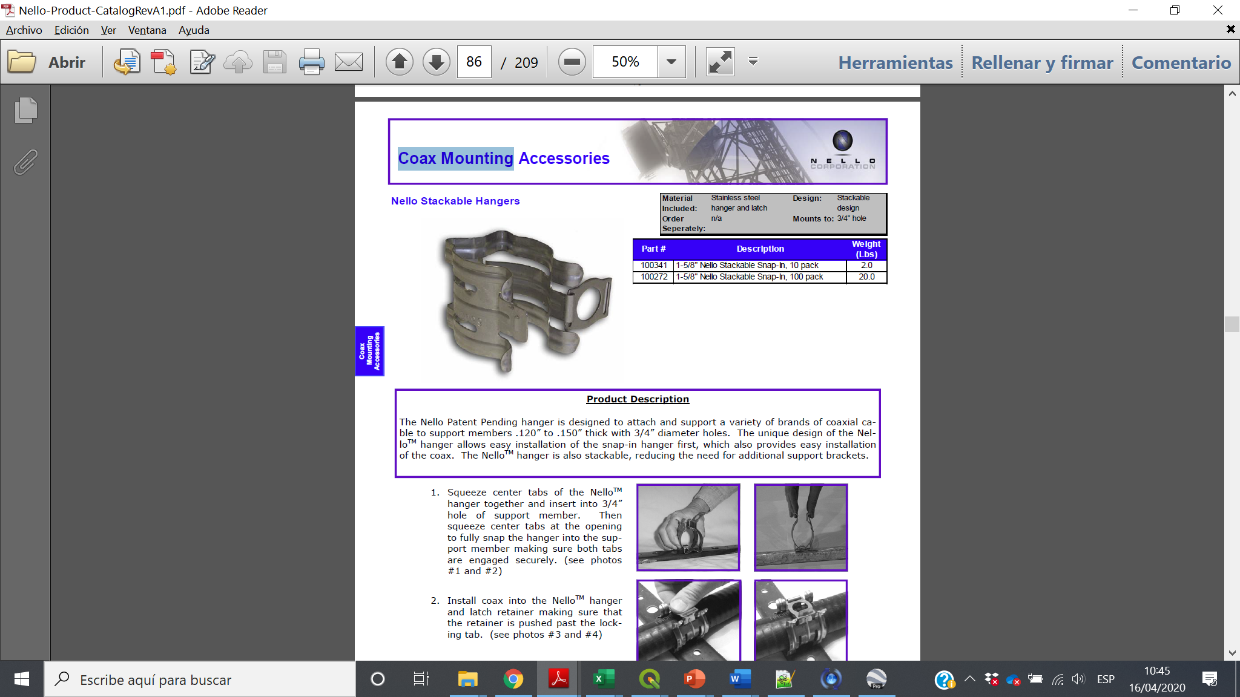
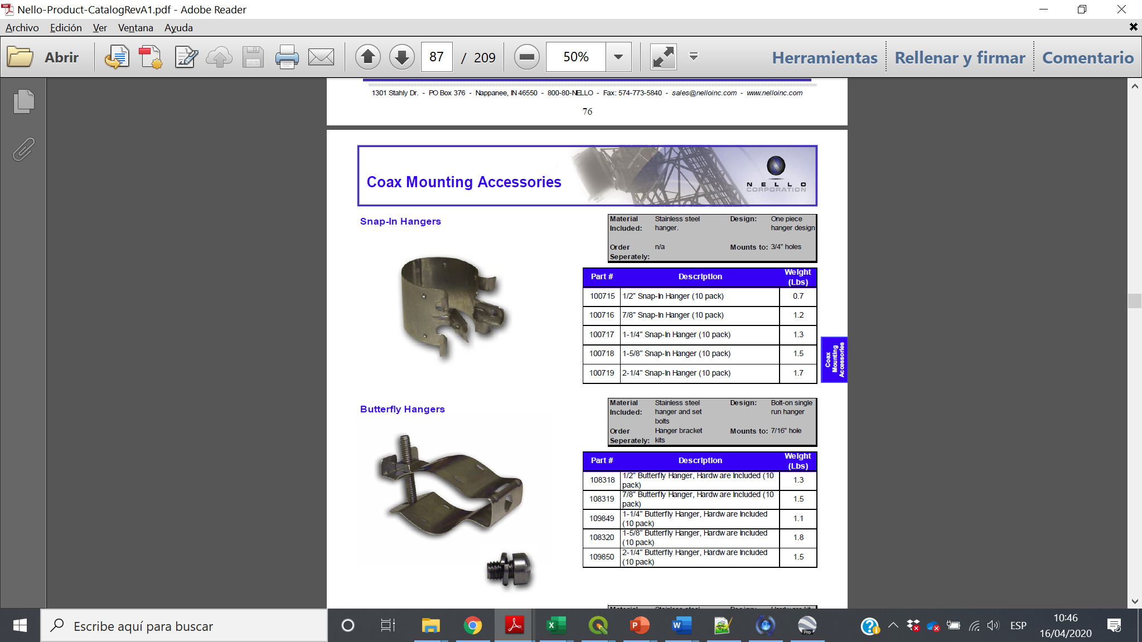
Section 3.1.3

Slide 49
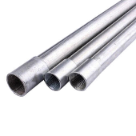
Section 3.3.1

Slide 50
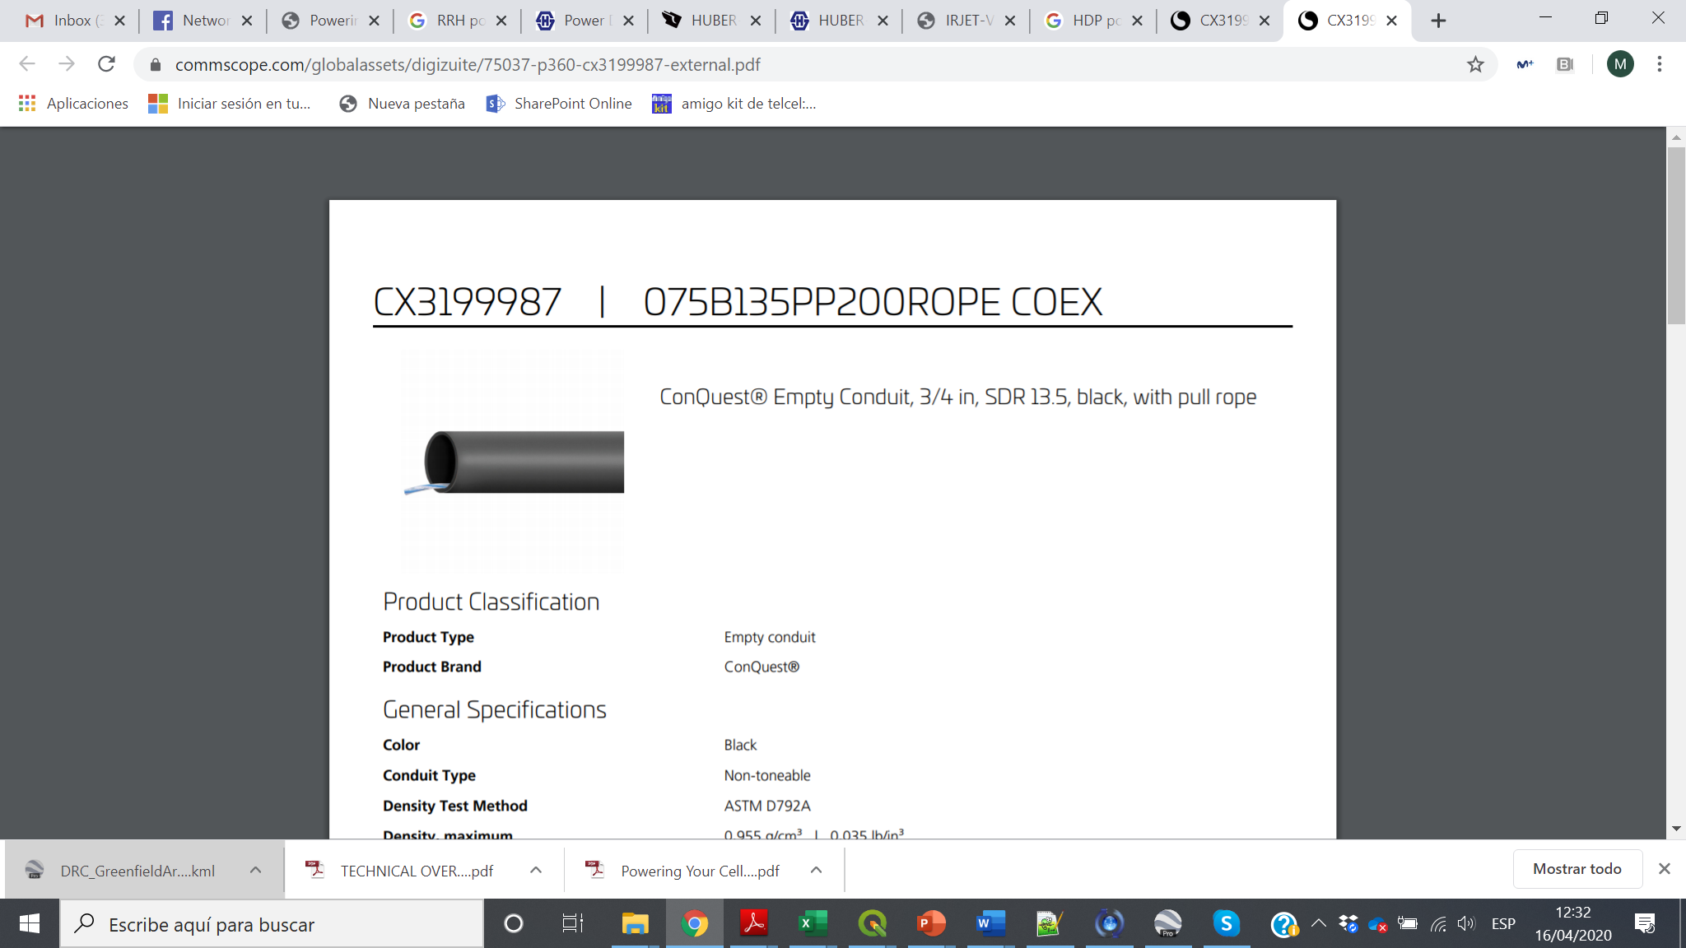
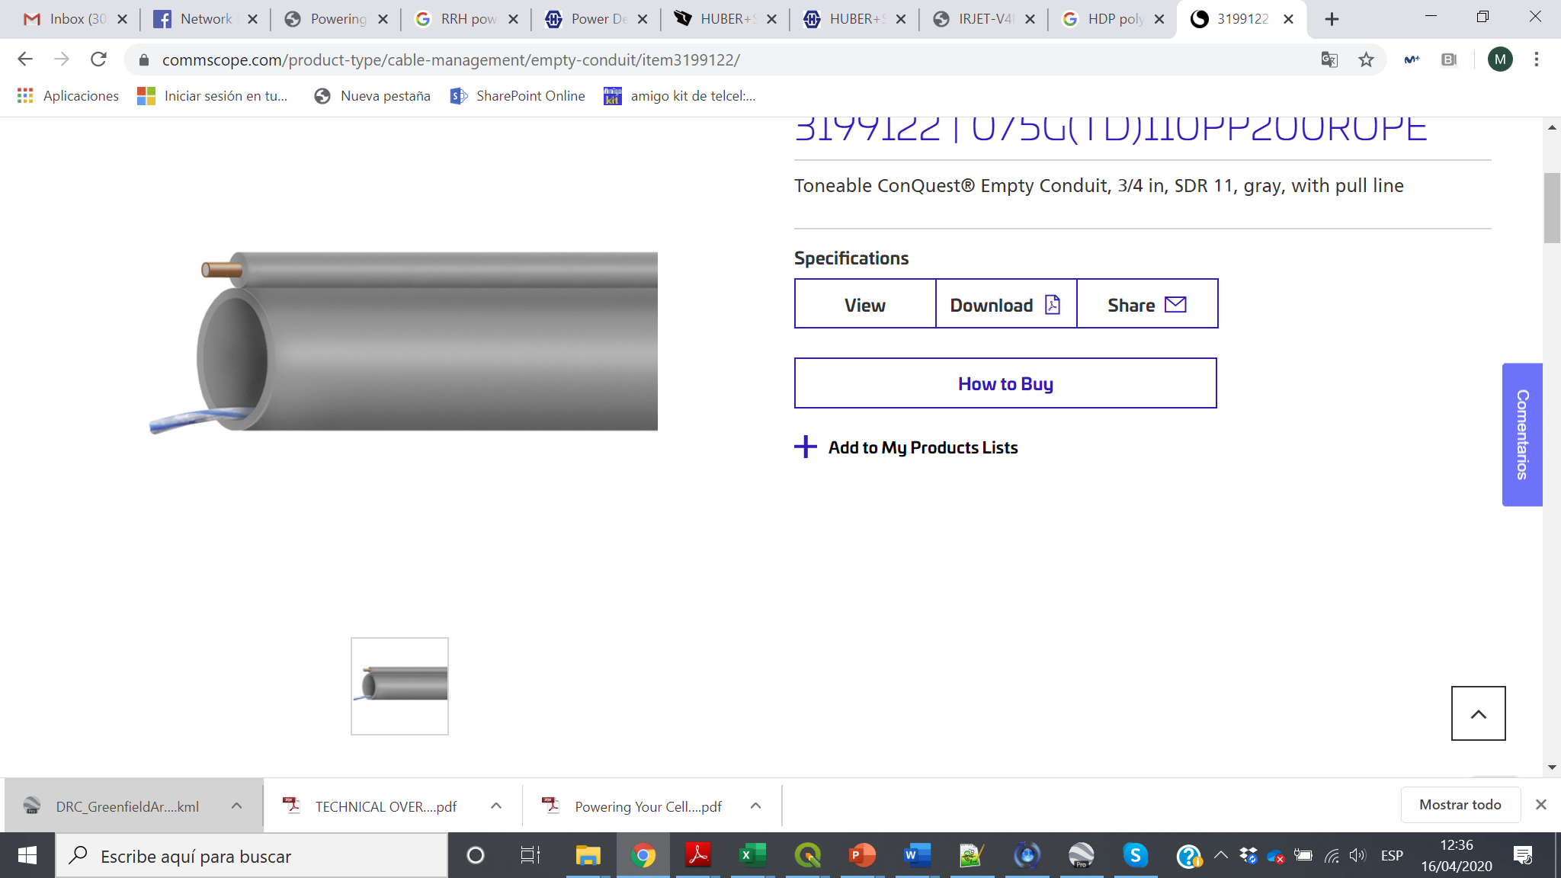
Section 3.3.1

Slide 51
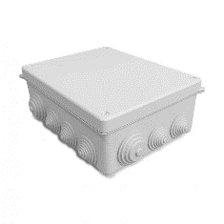
Section 3.3.1

Slide 52
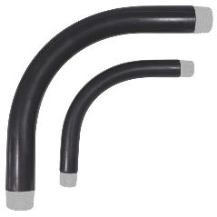
Section 3.3.1

Slide 53
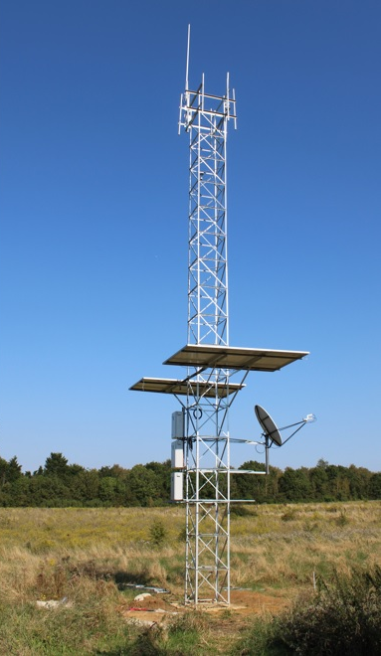
Section 3.3.2

Slide 54


Section 3.3.2

Slide 55

Section 3.3.3

Slide 56

Section 3.3.3

Slide 57

Section 3.3.4

Slide 58

Section 3.3.4

Slide 59


Slide 60


Slide 61


Slide 62


Slide 63


Slide 64


Slide 65


Slide 66


Slide 67



Slide 68

Section 3.5.3

Slide 69

Section 3.5.3

Slide 70

Section 3.5.3

Slide 71

Section 3.5.3

Slide 72

Section 3.5.3

Slide 73

Section 3.5.3

Slide 74

Section 3.5.3

Slide 75
RFx Preparation
RFx Execution
RFx Scope Statement
Gather RFx information
Size and Scope
Technical Requirements
Build RFx Document
Information for Bidders
Scope of Work
Proposal documents
Proposals Evaluation
Contract
RFx Distribution
Queries
Oral Presentations
Evaluation and Selection
Evaluate Proposals
Recommendation and Selection
Contract / MSA
RFx Project Chart
RFx Project Team
Identify and prequalify Bidders

Slide 76
RFI/RFP Document
Power Requirements
Safety Requirements
Shelter Requirements
Cabling Requirements
RFI/RFP objective
Tower Requirements
Grounding Requirements
Site Solutions
Scope and Deliverables
Construction Services
Operational Model
RFP Instructions
RFP Terms and Conditions

Slide 77
Primer Standard and Regulations Civil Aviation, Environmental and Radiation Emissions

Slide 78


Slide 79


Slide 80


Slide 81
Template B - Template B_Site Construction RFI_RFP_template_2020.06.03

Slide 82



RRUs and Antennas
MW Antenna
Tower mounted Cabinets:
Power
Baseband
Battery

Slide 83



Slide 84


Slide 85


